Slide 1
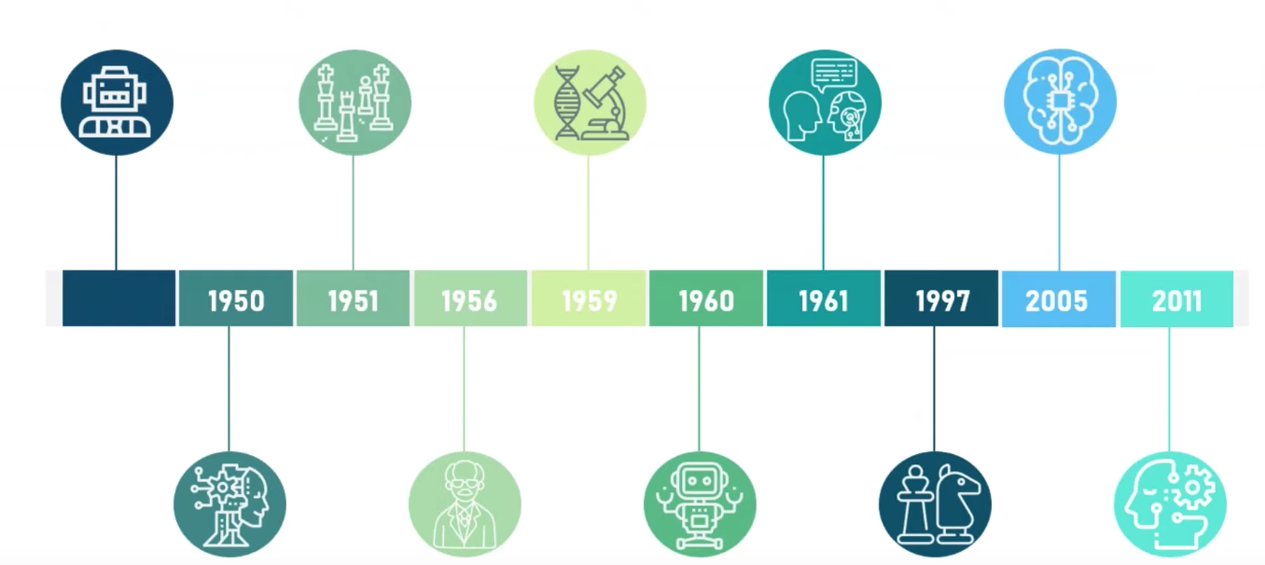
History of AI
1997 IBM Deep Blue
IBM’s Deep Blue beats world champion Garry Kasparov in the game of chess.
2011 IBM Watson
IBM’s question answering system. Watson, defeated the two greatest Jeopardy! champions, Brad Rutter and Ken Jennings.
1961 First Chatbot
The first AI chatbot called ELIZA was introduced in 1961.
2005 DARPA Grand Challenge
Stanford Racing Team’s autonomous robotic car. Stanley wins the 2005 DARPA Grand Challenge.
1951 Game AI
Christopher Strachey wrote a checker’s program and Dietrich Prinz wrote one for chess.
1950 Alan Turing
Alan Turing published a landmark paper in which he speculated about the possibility of creating machines that think.
1960 General Motors Robot
First robot was introduced to General Motors assembly line.
1956 The birth of AI
John McCarthy first coined the term “Artificial Intelligence” in 1956 at the Dartmouth Conference.
1959 First AI Laboratory
MIT AI Lab was first set up in 1959. The research on AL began.
Greek Mythology-Talos
Talos was a giant animated bronze warrior programmed to guard the island of Crete created by Hephaestus.

